Slide 1

Project of Social Information system

Slide 2
Dataset Information
Dataset Name: Twitter
Abstract: Twitter is a social news website. It can be viewed as a hybrid of email,
instant messaging and sms messaging all rolled into one neat and simple package.
It's a new and easy way to discover the latest news related to subjects you care about.

Slide 3
The Graph

Slide 4
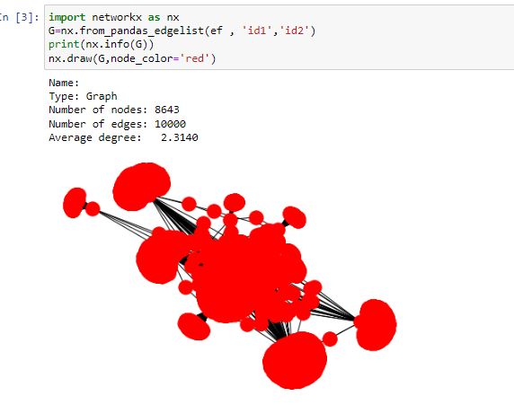

Slide 5
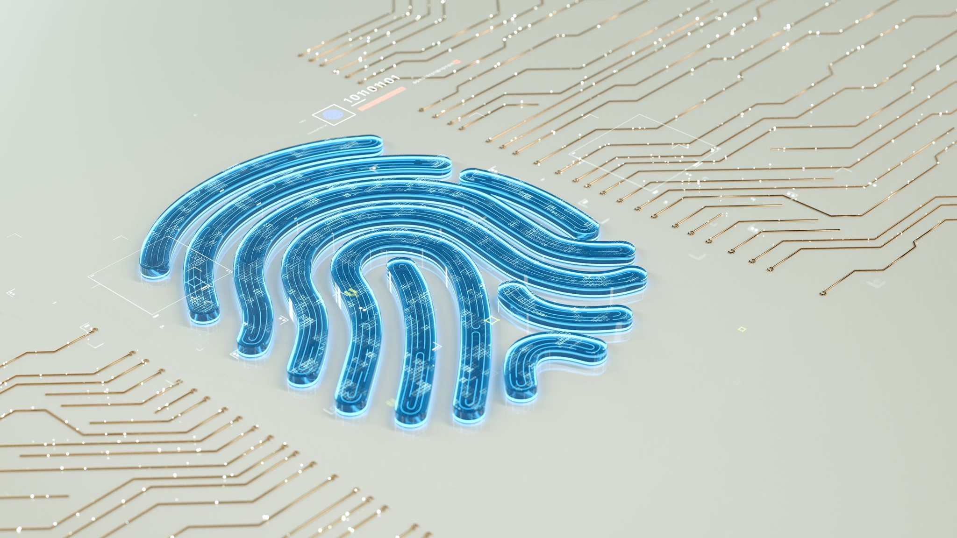
Community Detection

Slide 6
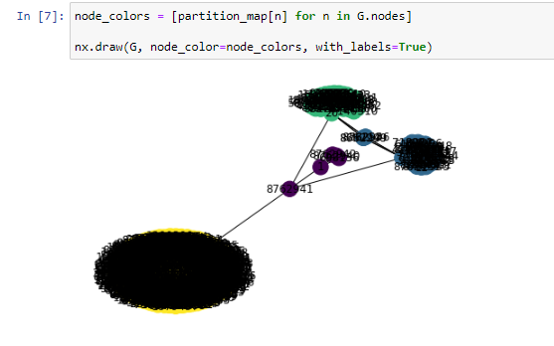

Slide 7
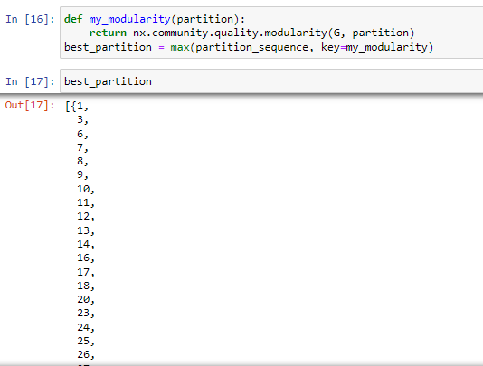

Slide 8
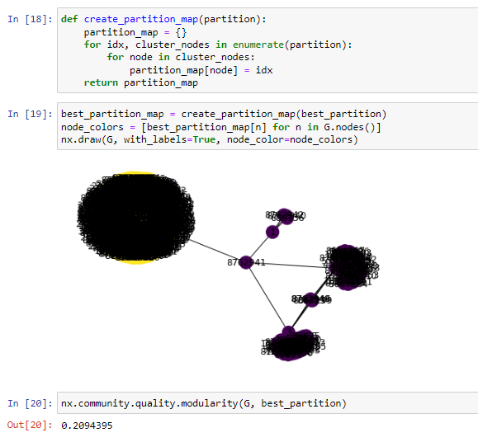

Slide 9
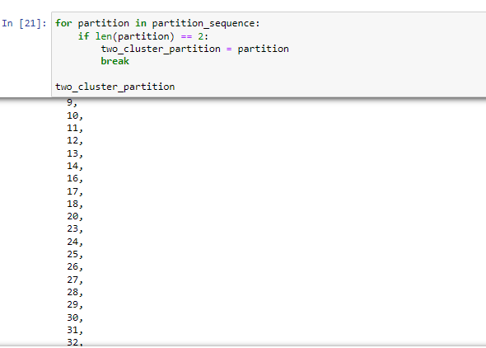

Slide 10
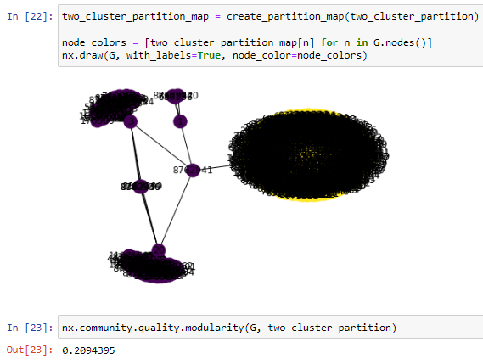

Slide 11

Degree Distribution and Adjacency Matrix

Slide 12
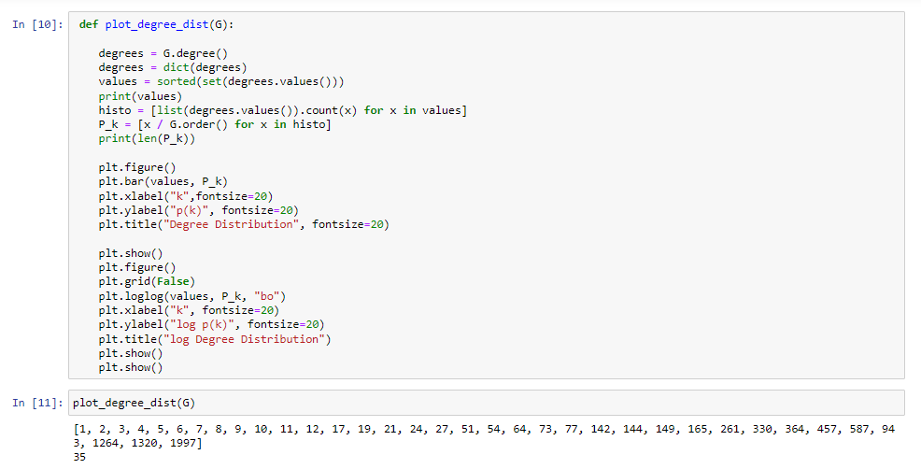
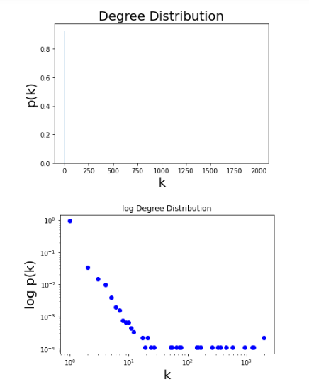

Slide 13
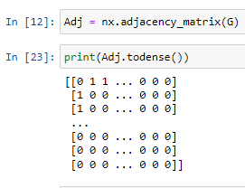

Slide 14

The Simulation

Slide 15
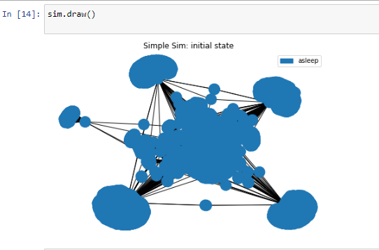

Slide 16
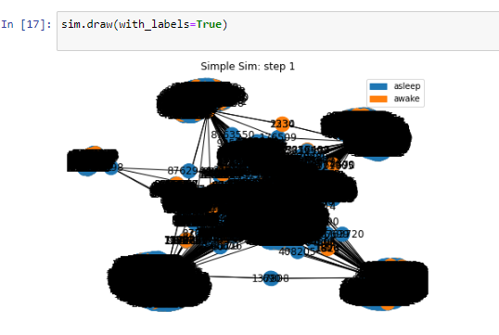

Slide 17
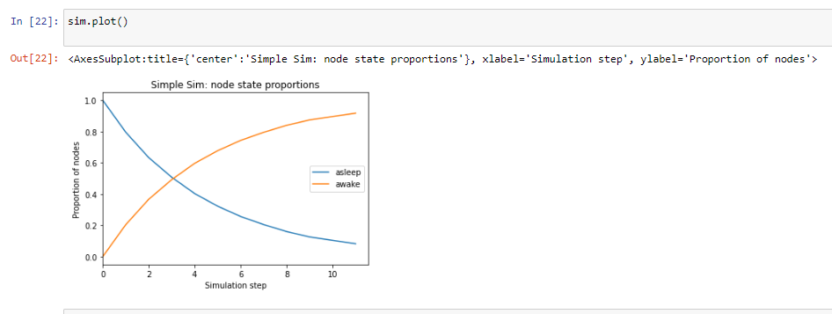

Slide 18
Made by:
1-Doaa Ibrahim Mohamed(section2)
2-Walaa Abdelhakeem Mohamed(section3)
3-Nehmedh Mohamed(section3)
4-Marwa Abdalla Ali(section3)
5-Aya Abdelazeem Hassan(section1)

